Slide 1
Object Oriented Analysis & Design Module-5 (RL 5.3.2)
Harvinder S Jabbal

Slide 2
Level & Partitions for Package Diagram

Slide 3
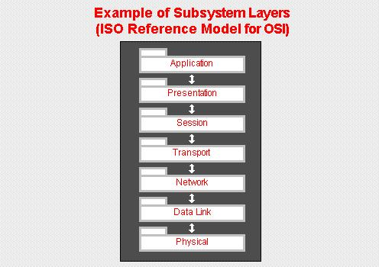
Levels for Package Diagram
Source: Defining Layers & Partitions in Architecture Topologies Craig Borysowich Dec 18, 2007 at toolbox.com
Ideally, this knowledge is one-way: each layer knows about the layer below it, but the converse is not true.
In a layered architecture model, classes within each subsystem layer provide services to the layer above it.

Slide 4
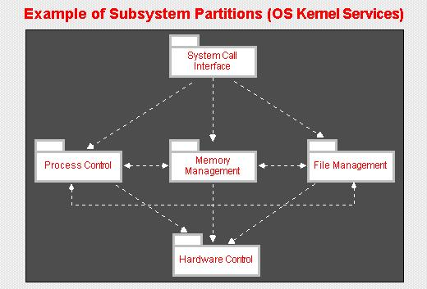
Partitions for Package Diagram
Source: Defining Layers & Partitions in Architecture Topologies Craig Borysowich Dec 18, 2007 at toolbox.com
In a partitioned architecture model, subsystems collaborate with peer subsystems at the same level of abstraction.

Slide 5
Partitions for Package Diagram
Classes within each subsystem partition can communicate with other classes in that partition.
Selected subsystem classes (assuming weak coupling) can communicate with designated classes from subsystem partitions that are at the same level as the subject subsystem.
Partitioning effects a vertical structuring of peer subsystems.
Like layers, each subsystem partition represents a group of classes that share similar functionality at the same level of abstraction.

Slide 6
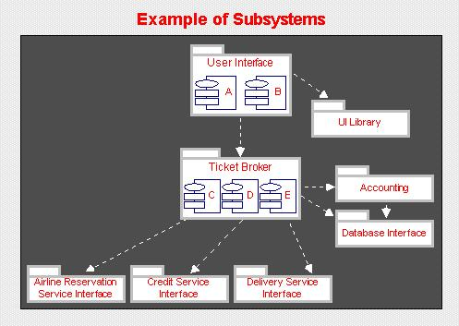
Levels and Partitions for Package Diagram
Source: Defining Layers & Partitions in Architecture Topologies Craig Borysowich Dec 18, 2007 at toolbox.com
Many large system architectures combine layers and partitions.

Slide 7
Levels and Partitions for Package Diagram
Example that combines layers and partitions
Subsystems, or components, are shown by labeled file folder shapes, and interfaces among subsystems are illustrated via arrows.
Several levels of abstraction are shown:
User Interface subsystem
At the highest level of abstraction is the User Interface subsystem, which provides the human-computer interface for the system.
The User Interface subsystem depends on theUser Interface Library subsystem, which contains tools for implementing user interfaces on different platforms, to provide a user interface framework.
In addition, it depends on the Ticket Broker subsystem for the business logic for brokering tickets.
Ticket Broker
The Ticket Broker subsystem layer contains two partitions, one for Ticket Broker and one for the Accounting subsystem. The Accounting subsystem organizes the modules that manage customer accounts.
Both of these depend on the Database Interface subsystem that provides persistent object services.
The bottom layer contains partitions for the Reservations Interface, Delivery Service and Credit Authorization Interface subsystems, which interface with external reservation, delivery, and credit services, respectively.

Slide 8
Acknowledgement
Slides are based on Course Text Books:
Applying UMP and Patterns (An Introduction to Object-Oriented Analysis and Design and Iterative Development) : Craig Larman
UMP Distilled (A Brief Guide to the Standard Object Modeling Langauge) : Martin Fowler
Design Patterns (Elements of Reusable Object-Oriented Software) : Erich Gama | Richard Helm | Rapph Johnson | John Vlissides alias GoF.
Also: http://agilemodeling.com/style/packageDiagram.htm
http://www.uml-diagrams.org/package-diagrams.htm

